Slide 1
Basic git and singularity
COVID-19 project at AAU
Kasper Skytte Andersen
(not to be presented)

Slide 2
Git basics
4 main phases in the lifecycle of a git repository (visualised next slide):
remote repo
A tracked repository (by git), can be more than 1 (eg from forks). Main repo is the “origin”
local repo
“cloned” from a remote (mostly the origin)
index
keeps track of changes (and what to change with commits)
local workspace
the actual files and folders you are working on/in
(stash)
save changes for later, or discard, can be “pop”’ed to applied again/merged
Branches persist through all phases, useful for testing/development/variations

Slide 3
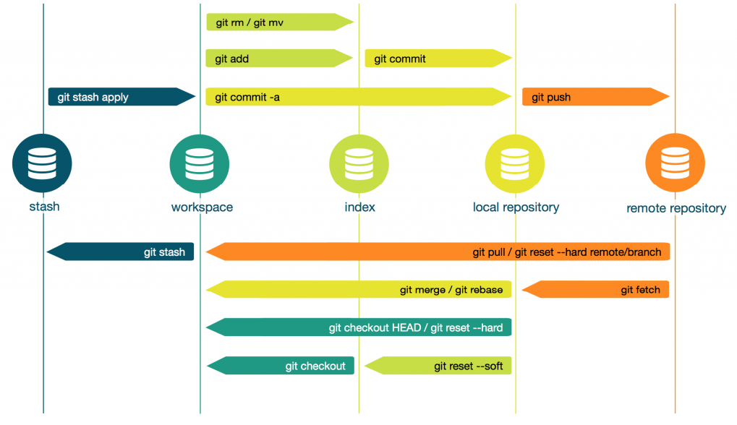

Slide 4
Git basics
Most vital commands / keywords:
$ git init [name]: create an empty repo. Easier to create repo on github.com if that’s where the origin will be, then clone it locally
$ git clone [url]: clone/copy a repo from a remote
$ git status: list changes not yet committed
$ git checkout [v1.2]: update WD to a specific branch/commit/tag/release
$ git add [file]: add a file to the staging area (to be committed)
$ git commit -m [“message”]: commit changes in staging area with message
$ git fetch: check for changes on remote/origin without updating anything
$ git pull: get latest changes from remote/origin and update WD
$ git push: push changes from local repo to remote/origin repo

Slide 5
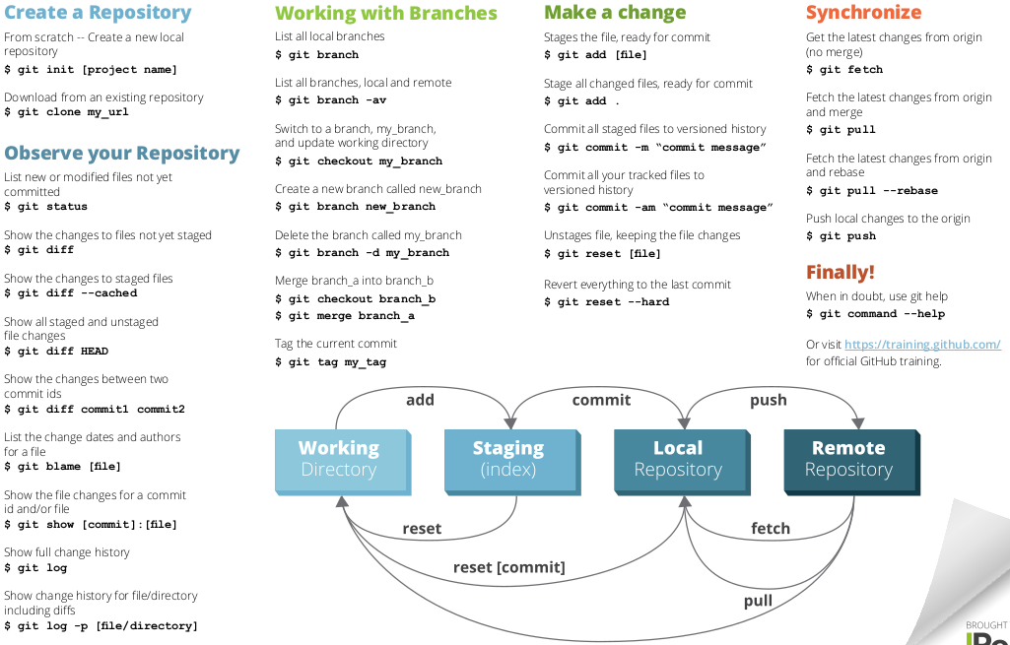
pull
CLI cheat sheet here: https://www.jrebel.com/system/files/git-cheat-sheet.pdf (just use a GUI)

Slide 6
Git GUI clients
Best visualised = use a GUI client!
* github desktop (only windows+mac)
* gitkraken (best cross platform imo, has nice extras, free pro version through the github student pack https://education.github.com/pack + others)
* SourceTree (cross platform, developed by Atlassian, same as Trello+Jira)
* SmartGit (cross platform, also for SVN)
sublime merge (sublime text is an awesome text editor)
RStudio! (very basic)
* = supports pull requests

Slide 7
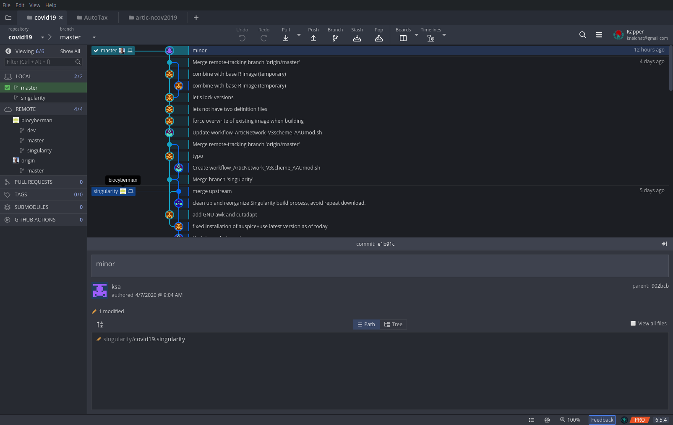

Slide 8
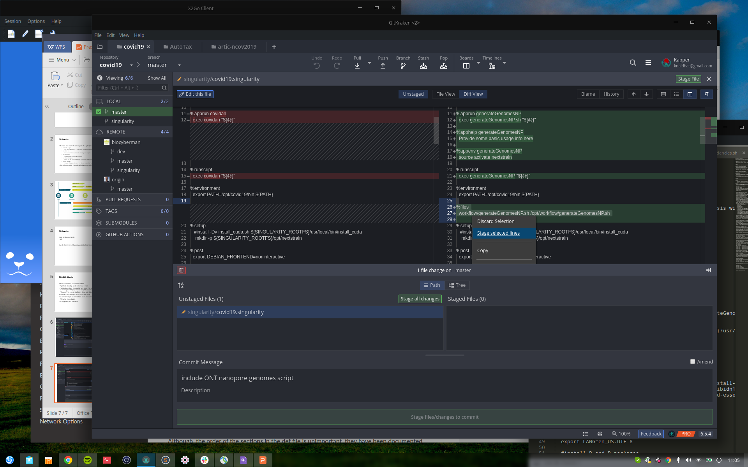

Slide 9
Git best practices
Make meaningful commit messages!
It’s a summary of certain changes
The problem/addition should be clear from the message, and keep different problems/additions in separate commits
fx “updated script” is meaningless, it’s obvious since you just committed, use instead: “added feature xx”, “fixed bug #10”, “changed default setting x to y” etc
Commit early, commit often!
Keep your collaborators and the rest of the world up to date
Break down larger changes into separate commits if possible, you don’t have to commit one file as one whole commit. It only takes a second to select particular lines related to a (one!) problem if using a git GUI app
Don’t commit half-done or untested work
Other people would love you for it
Undocumented software is useless to others! At minimum have a repository readme with usage, installation, features, examples, etc

Slide 10
Singularity containers
Integration over isolation
Does not require elevated privileges like docker (though rootless docker exists)
Boils down any workflow into a single, portable, image file, including:
OS (only Linux)
All required software tools
Scripts
Start a container based on the image, provide input data, get output!
https://sylabs.io/guides/3.5/user-guide/index.html
5 min intro here: https://www.youtube.com/watch?v=m8llDjFuXlc

Slide 11
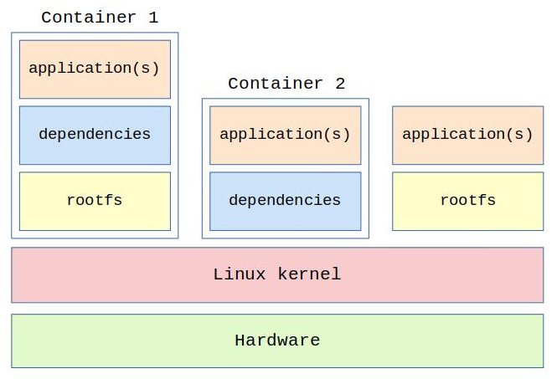
Containers in general

Slide 12
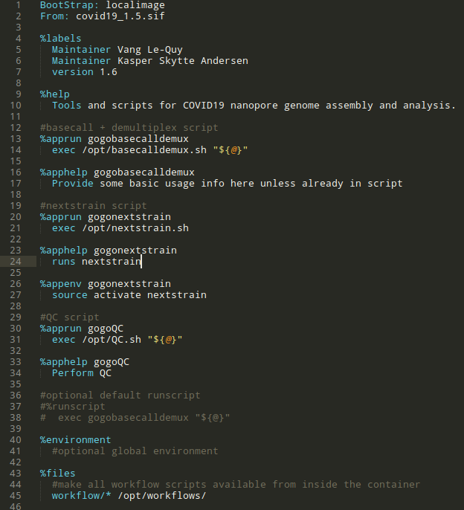
Singularity + git
example image definition file
covid19 git repository
- basecalldemux.sh
- nextstrain.sh
- covid19.singularity
- ...
Build singularity image based on definition file, copy all workflow scripts along
Start container on host and run scripts with input data
$ singularity run --app gogobasecalldemux covid19.sif -i fast5/ -o fastq/
$ singularity run --app gogonextstrain covid19.sif -i fastq/ -o somefolder/
$ singularity run --app gogoQC covid19.sif -i somefolder/

Slide 13
Building singularity image on the secure server
Developing scripts
Develop scripts as we’ve done until now by using the container as a virtual environment with singularity shell /srv/rbd/covid19/thecontainer/covid19_latest.sif
When done developing: Integrate scripts and rebuild image
Go to a clone of the github repo (you should only be working in your own)
Update app definitions if neccessary in covid19.singularity (probably only once, the first time)
Hit make while in the singularity/ subfolder
This will build base image and the main image on top into 2 .sif files
Please test manually! (since we haven’t set up automated tests, best practice but takes time)
(Merge into workstations branch if neccessary)

